Slide 1

DSC680 – Project 2 Applied Data Science Web Scraping – Flight price Prediction Sri R Sankaranarayanan
Humble Attempt to web scrape popular travel sites for analyzing the flight ticket price

Slide 2
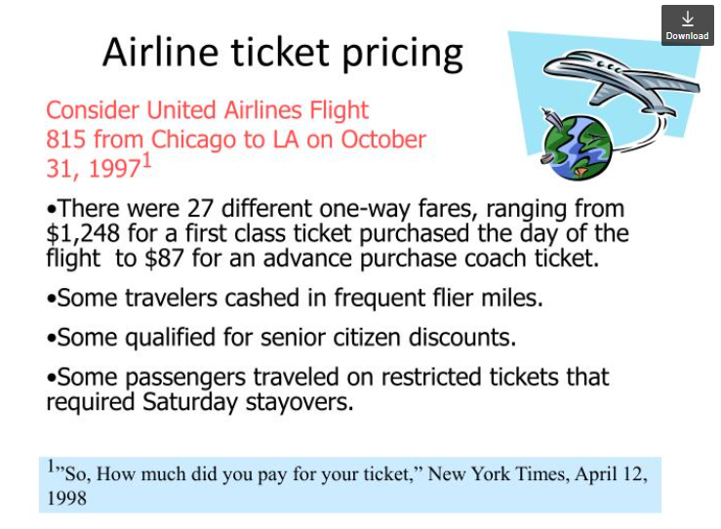

Fight Ticket Price Analysis - Synopsis

Slide 3
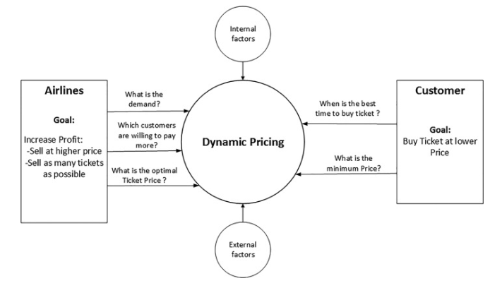
Flight Ticket price Analysis - Analogy
Notes:
Short doubling times, some measured in minutes; time is an important factor with microbial infections
Culturing bacteria for ID methods takes time and so do genetic testing methods
Technicians can look at organisms under a microscope and maybe get a broad reading of the microbe type; subjective and variable
ID is used to determine precise treatment options; without ID, broad spectrum antibiotics are used, leading to antibiotic resistance

Slide 4

Flight Ticket Price Analysis – Web Scraping
The scraper output will include these features:
Departure time
Arrival time
Airline
Duration (flight duration)
Stops (number of stops)
Layovers
Price
Airplane type
Departure Coach
Arrival Coach
Departure airport name
Arrival airport name
The exact time the scraping was performed
Notes:
Short doubling times, some measured in minutes; time is an important factor with microbial infections
Culturing bacteria for ID methods takes time and so do genetic testing methods
Technicians can look at organisms under a microscope and maybe get a broad reading of the microbe type; subjective and variable
ID is used to determine precise treatment options; without ID, broad spectrum antibiotics are used, leading to antibiotic resistance

Slide 5
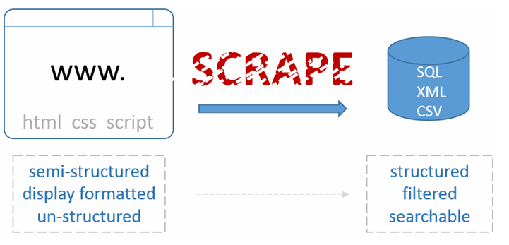
Flight Ticket Pricing using selenium – Web Scraping to structured Data
Notes:
Measurements automatic; many similar / correlated, how selected? Better choices (NN)?; skew; optimal features? All
Target variable: 10 microorganisms; imbalance (25% / 2%); class_weight=‘balanced’ (modest improvement); sampled/resampled to average number – lowered metrics for all, but using 25% less data;
Representative of real-world? Of their class (species)?; diatoms are quite varied

Slide 6
Baseline Packages
Python Selenium
GradientBoostingClassifier
Xpath selectors
Notes:
Metrics considered: Accuracy, F1-Score, Precision, Recall; all were comparable to Accuracy; hyperparameter tuning using GridSearchCV

Slide 7

Conclusion
The idea is to learn and perform web scraping using Python – this humble attempt of finding the best possible Flight deals is personal milestone and I would like to leverage this to other areas like home search sites, web scrape review sites and then perform sentimental analysis.
Notes:
Given the comparable results between RFC and DTC, proceed w/DT because easier to interpret (troubleshooting & further analysis/improvement) and ~10x faster
Generate more data; expand to more microbe taxons and try different genera or species within a taxonomy; look for other useful measurements
Allow NN to directly extract features useful for classification

